Slide 1
Obesity
By: Ken Davies Jr.

Slide 2
Like WOW…
http://www.youtube.com/watch?v=K_ffSw-z_FE

Slide 3
OVERVIEW
Fast food restaurants
Poor parental guidance on what children should consume.
Lack of Physical education

Slide 4
Ba buh buh buh baaa I’m lovin it….not really
http://www.youtube.com/watch?v=4N5i-0t8m94

Slide 5
Fast Food Restuarants
Commercials all over the TV sets at home persuading young children to eat this stuff!
Nearly at every corner of every town and city there are fast food places. Also rest stops are filled with them.
This greasy food is far from healthy, but having a sedentary lifestyle with constant fast food consumption I definitely going to cause health issues and most likely obesity.
www. Eyesword.com

Slide 6
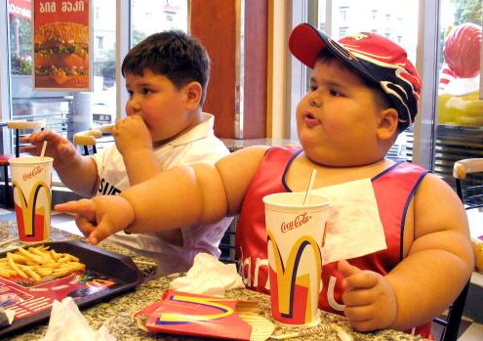
OoPs =(
http://www.treehugger.com/files/2011/02/fast-food-advertising-focus-minority-youth-kids-continue-grow-fatter-whats-wrong-with-this-picture.php
Notes:
fdvSD

Slide 7
Poor Parental Guidance
Children are highly influenced by what their parents eat. Example….. parents who consume a high amount of soda have a good chance that their children will do the same.
- “Teens whose parents drink soda every day are nearly 40 percent more likely to drink soda every day themselves than teens whose parents do not drink soda.”- Live Science Staff
- Low income parents who need to run to the fast food places often for breakfast, lunch, and or dinner for their children, will likely be huge contributors towards their unhealthy growing children
LiveScience Staff
Date: 09 February 2009 Time: 08:20 AM ET

Slide 8
Phys. Ed. Anyone? http://www.pecentral.org/BulletinBoard/ViewBulletinBoard.asp?ID=348

Slide 9
Lack of Physical Education!
http://www.boston.com/yourlife/health/children/articles/2007/05/30/lack_of_physical_education_weighs_heavily_on_many/
Children across the U.S. aren’t getting the P.E. time they need. Only a few states require P.E. within the school system.
No Child left Behind Act. And the test taking that stresses out the students.
P.E. suffers because that act that was in place for a good amount of time. Its slowly growing at the present time cause Obama and his wife stress the P.E. programs as Important.

Slide 10
RECAP
Fast food
Poor parental guidance
Lack of physical education
What I’ve noticed.. With everyone on the go on a day to day basis, the idea of healthy, hardly comes to mind for many and therefore fast food becomes the food of choice.

Slide 11
These are my sources
“ Parents Blamed for Childhood Obesity. 9 Feb. 2009. Web. 3 Oct. 2011.
Wangness, Lisa.” Lack of Physical Education Weighs Heavily on Many.” The Boston Globe 30 May 2007. page. Print
www.boston.com/yourlife/health/children/articles/2007/05/30/lack_of_physical_education_weighs_heavily_on_many/
http://www.pecentral.org/BulletinBoard/ViewBulletinBoard.asp?ID=348
http://www.treehugger.com/files/2011/02/fast-food-advertising-focus-minority-youth-kids-continue-grow-fatter-whats-wrong-with-this-picture.php
“ Can fast food Cause Obesity? Scientists Study the Links.” Web. 4 Oct. 2011.
http://www.youtube.com/watch?v=4N5i-0t8m94
http://www.youtube.com/watch?v=K_ffSw-z_FE

Slide 12
So…What do you think?
Questions?…..
THE END!

