Slide 1
Obesity
*LAS Major*
By: Kenny Davies Jr.

Slide 2
Let’s Begin
http://www.youtube.com/watch?v=UwLbEsukhrk

Slide 3
Overview
The problem
Healthy Eating
The consequences of poor eating habits

Slide 4
uh…
http://img4.southernliving.com/i/2009/02/chocolate-delights/chocolate-italian-cake-l.jpg?400:4

Slide 5
The Problem
16% – 33% of children and adolescents are obese.
30,000 deaths or more a year.
Obesity is growing FAST! .. Technology, sedentary lifestyle. Etc.
http://www.stop-childhood-obesity.com/childhood-obesity-statistics.html

Slide 6
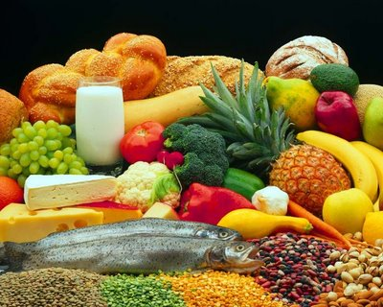
Food
http://media4.onsugar.com/files/2011/08/33/3/1852/18523990/a79436af8f6c52aa_Healthy_Food_Pictures_Free_A.j

Slide 7
Healthy Eating
Pros –
1. Leaner meals = healthier life !
2. Eating well-balanced meals with an active life style ensures good health.
http://www.theyesword.com/fast_food_cause_obesity.htm
Cons
1. Bad Food (fast food) = struggling Life
2. Disease.
3. Healthy food can be to much for the wallet.
(Common knowledge about healthy food Is that the organic foods are pricey. )

Slide 8
Bad health
http://www.youtube.com/watch?v=H5mEym9Iszs

Slide 9
Consequences of Poor Eating
http://www.webmd.com/diet/tc/obesity-health-risks-of-obesity
Type 2 diabetes, high blood pressure, high cholesterol ad triglycerides, sleep apnea, a stroke, and coronary artery disease (CAD).
Children with obesity have long term health problems if they don’t do something about it! ( sedentary behavior, school lunches, lack of P.E.)
People who eat correctly and also expend more calories then consumed with keeping active, reduce their bad health risks by a longshot.
Obesity can also shorten a life span if not taken care of.

Slide 10
Recap
Problem
Healthy eating?
Consequences of poor eating!

Slide 11
Sources =-)
http://img4.southernliving.com/i/2009/02/chocolate-delights/chocolate-italian-cake-l.jpg?400:400
http://media4.onsugar.com/files/2011/08/33/3/1852/18523990/a79436af8f6c52aa_Healthy_Food_Pictures_Free_A.j
http://www.youtube.com/watch?v=UwLbEsukhrk
Barns, Jeff. "Child Obesity Statistics." 1 Jan. 2011. Web. 5 Nov. 2011.
"Can Fast Food Cause Obesity? Scientists Study The Risks.." Web. 7 Nov. 2011.
"Obesity- Health Risks of Obesity." Web. 7 Nov. 2011. <http://www.webmd.com/diet/tc/obesity-health-risks-of-obesity>.

Slide 12
The End
Any questions???????????
Kjd5199@psu.edu

